Slide 1

DAB 203
PROJECT
PROPOSAL
Notes:
Links:
https://www.pexels.com/photo/photo-of-people-holding-each-other-s-hands-3184423/

Slide 2



THE
TEAM
Saharsh Sinha
Hitarth Mehta
0783417
0776102
Notes:
Links:
https://www.pexels.com/photo/man-wearing-black-and-white-stripe-shirt-looking-at-white-printer-papers-on-the-wall-212286/

Slide 3




Slide 4

“
Due to pandemic public transportation has become risky so we want to look at the current used car market in CANADA & USA.
Our goal is to see the brands, market presence , price and popularity in the both countries by querying the dataset.
This will help anyone who wish to buy a used car with reasonable price.
We also want to analyze and compare the current market of United States and Canada as per 2021.
OUR
GOAL
“
Notes:
Links:
https://www.pexels.com/photo/top-view-of-people-at-the-meeting-3184287/

Slide 5


DATASET
SOURCE
Dataset Overview
Canada and USA used car dataset
https://www.kaggle.com/rupeshraundal/marketcheck-automotive-data-us-canada
Data Source Owner- Rupesh Raundal
Description-
Individual listing records show year, make, model and trim, with VIN-level histories, showing the most recent time the car showed up online back to the earliest, with every change that occurred over that time.
The dataset has the aggregate data from various used car dealers across Canada and United States
Notes:
Links:
https://www.pexels.com/photo/top-view-of-people-at-the-meeting-3184287/

Slide 6
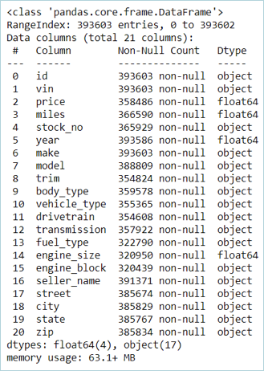
DATASET
OVERVIEW
Dataset Overview
Canada and USA used car dataset
The data in US dataset 7,104,304 records and 21 columns and the Canada dataset has 393,602 and 21 columns.
The dataset has 4 numeric columns and 17 object type columns
The columns have all the specification as per a car .
Notes:
Links:
https://www.pexels.com/photo/top-view-of-people-at-the-meeting-3184287/

Slide 7

COMMUTE SCENARIO
Driving
65% Canadians prefer driving for commute
65%
Carpool
12.3 % Canadians prefer carpool
12.3%
Bus
8% of the people rely on Buses
8%
Subway
4.5% of people rely on subway or elevated rails.
4.5%

Slide 8





OUR
APPROACH
DATA
DATA CLEANING
SQL SCRIPTS
DASHBOARD / USABLE APP
The data set contains updated records of used cars in Canada and USA. The data set is updated latest to May 2021
We will use python to do initial EDA and SQL for data cleanup. The goal of cleanup is to make sure to get rid of inconsistencies
Our Analysis will include MYSQL queries to look deeper in data to find relevant pattern and tunnel the results.
Post SQL scripting we aim to provide an interactive dashboard/ app for the users to interact.
Notes:
Links:
https://www.pexels.com/photo/man-wearing-black-and-white-stripe-shirt-looking-at-white-printer-papers-on-the-wall-212286/

Slide 9

Task
Distribution
DATA Preprocessing
SQL SCRIPTS Management
DASHBOARD(FE) OR USABLE APP Creation
This task involves Data Cleaning , Removing unnecessary records and Inserting it into the Database Table
This task involves writing script to insert data into the table, creating and updating table, writing reusable stored procedure and query optimization script.
This step involves user interactive Front-end creation for better visualization of our processed data.
Saharsh
Hitarth & Saharsh
Hitarth
Notes:
Links:
https://www.pexels.com/photo/man-wearing-black-and-white-stripe-shirt-looking-at-white-printer-papers-on-the-wall-212286/

Slide 10

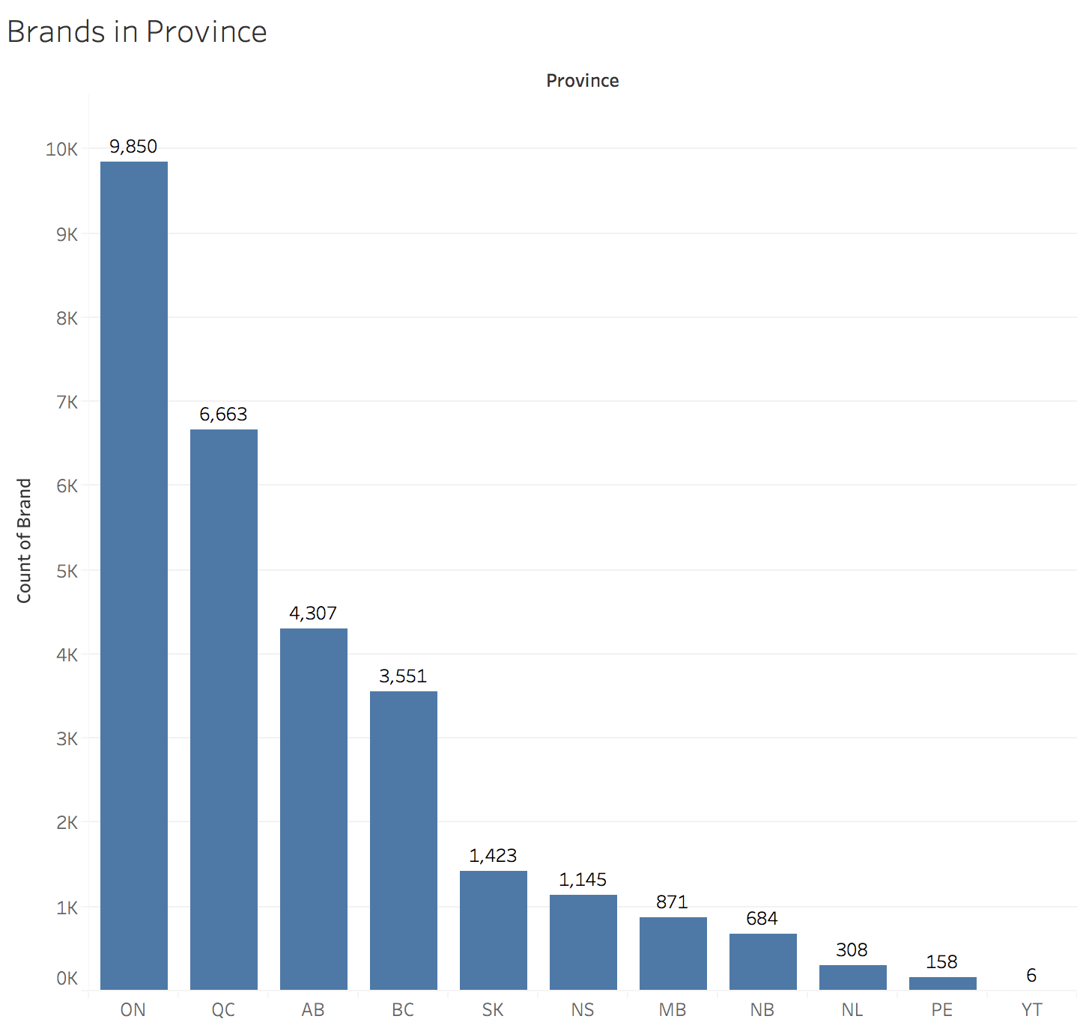
INITIAL ANALYSIS
The initial analysis shows that Ontario has highest frequency of Car Brands followed by Quebec , Alberta and British Columbia
Notes:
Links:
https://www.pexels.com/photo/civil-engineer-planning-dam-3862365/

Slide 11
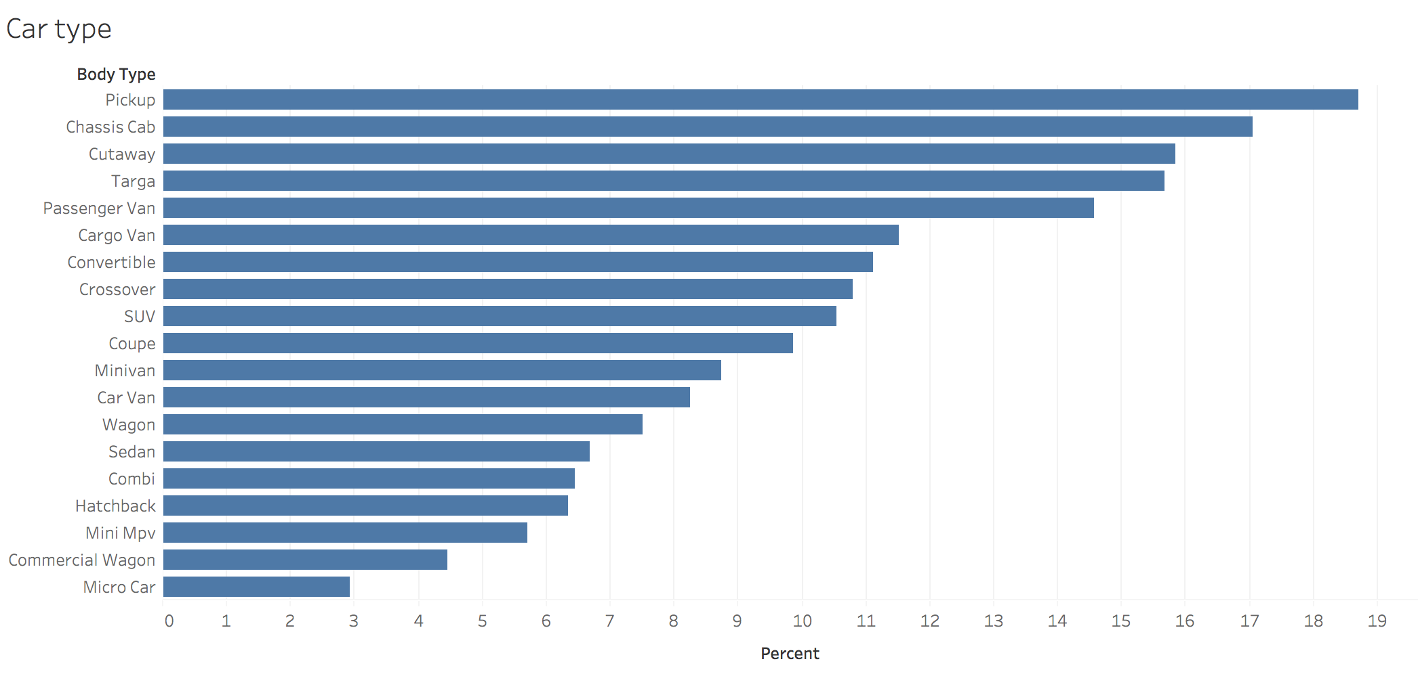
INITIAL ANALYSIS
The bar chart shows the percent of car – type in the Canadian market.
Notes:
Links:
https://www.pexels.com/photo/civil-engineer-planning-dam-3862365/

Slide 12

SQL SCRIPTING
Data Cleaning and Queries
1.
4.
Comparison with both countries
Explore Country-wise data
2.
5.
Explore State/ Province wise distribution.
Brand /Price/ Frequency
3.
6.
Region wise Distribution
Dealership Ranking Through years
Notes:
Links:
https://www.pexels.com/photo/female-engineer-planning-dam-3862389/

Slide 13
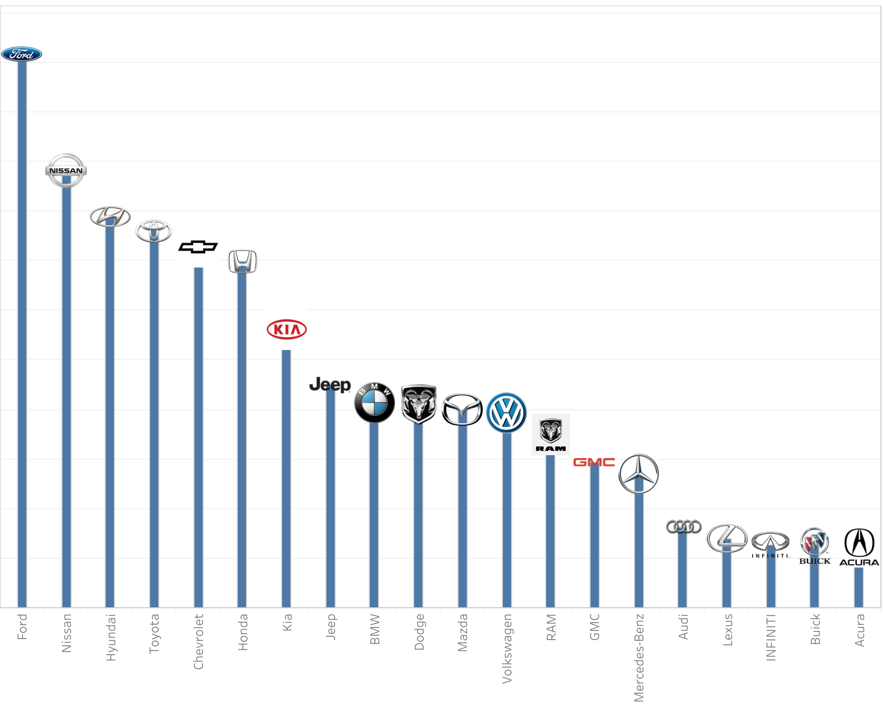
FINDINGS
TOP 20 BRANDS IN CANADA
FORD
NISSAN
HYUNDAI
TOYOTA
CHEVROLET
HONDA
KIA
JEEP
BMW
DODGE
MAZDA
VOLKSWAGEN
RAM
GMC
MERCEDES-BENZ
AUDI
LEXUS
INFINITI
BUICK
ACURA
Notes:
Links:
https://www.pexels.com/photo/female-engineer-planning-dam-3862389/

Slide 14
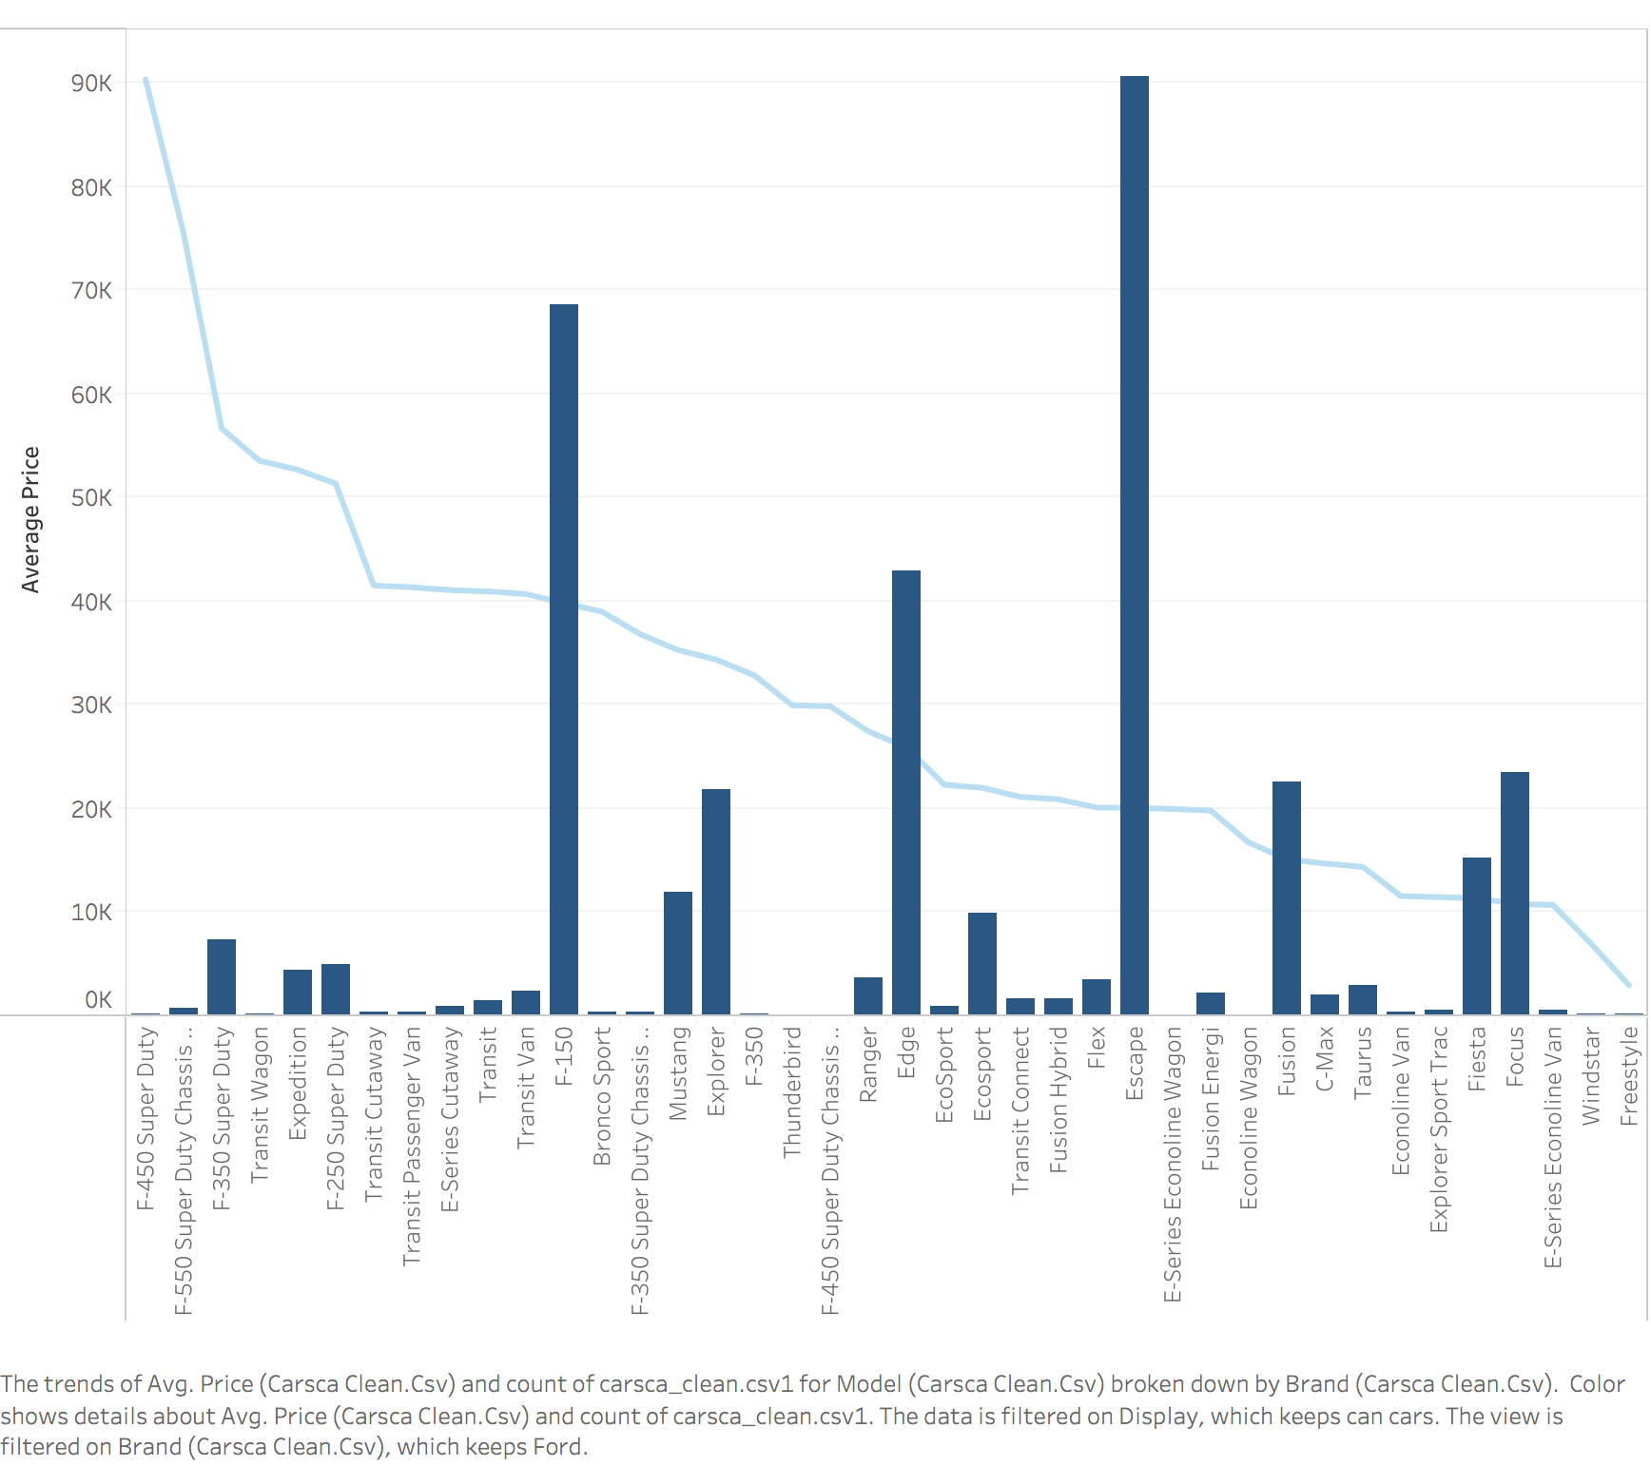
FINDINGS
FORD CANADA
We see top 5 Ford cars sold in Canada
Eclipse
F-150
EDGE
EXPLORER
FUSION
Notes:
Links:
https://www.pexels.com/photo/female-engineer-planning-dam-3862389/

Slide 15
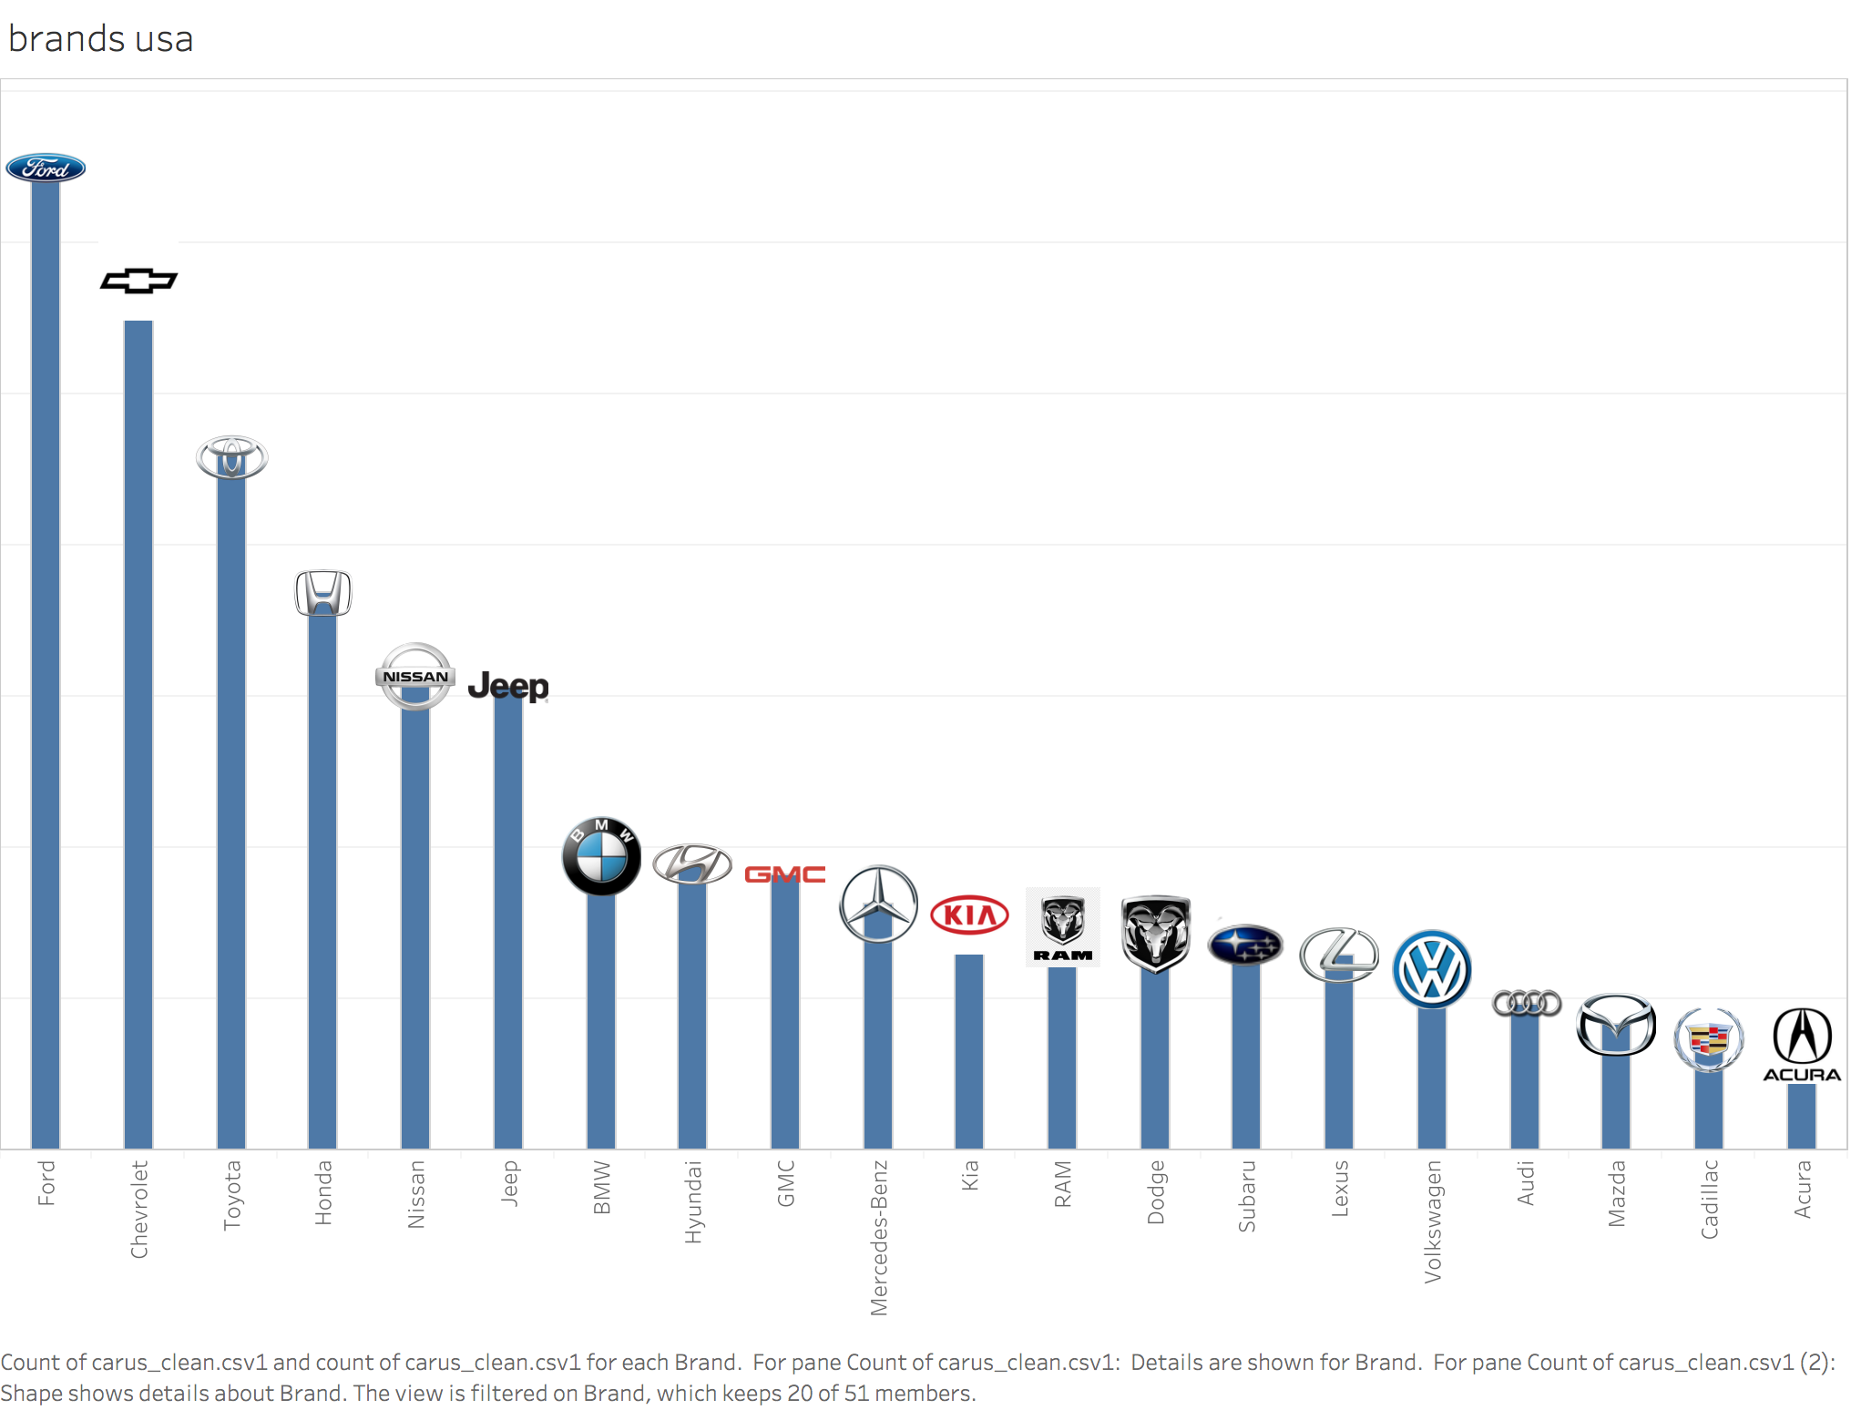
FINDINGS
FORD USA
FORD
CHEVROLET
TOYOTA
HONDA
NISSAN
JEEP
BMW
HYUNDAI
GMC
MERCEDES-BENZ
KIA
RAM
DODGE
SUBARU
LEXUS
VOLKSWAGEN
AUDI
MAZDA
CADILLAC
ACURA
Notes:
Links:
https://www.pexels.com/photo/female-engineer-planning-dam-3862389/

Slide 16
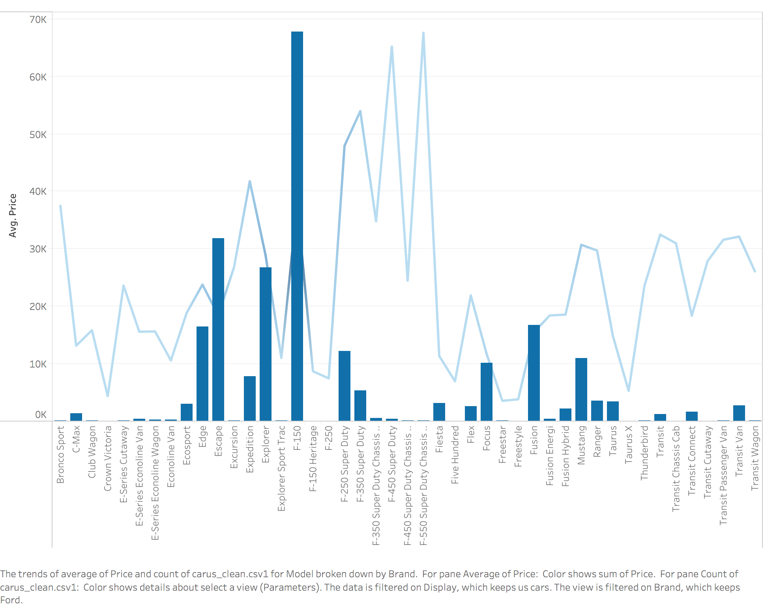
FINDINGS
FORD USA
The top 5 cars by Ford sold in USA are
F-150
ECLIPSE
EXPLORER
EDGE
FUSION
Notes:
Links:
https://www.pexels.com/photo/female-engineer-planning-dam-3862389/

Slide 17
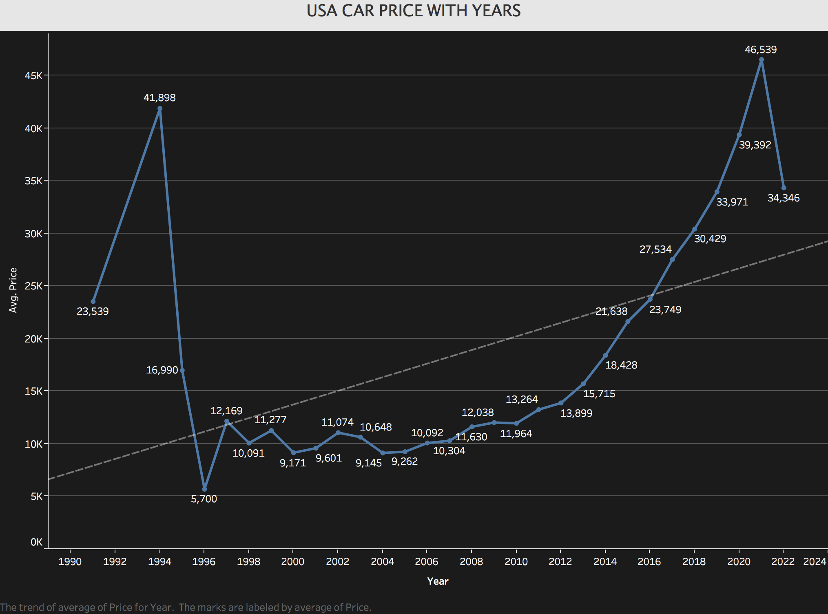
FINDINGS
PRICES VS YEARS - USA
We observe that
years 1992 and 2021 have
Higher average price of
vehicles
The lowest price point has
Cars from 1996
Notes:
Links:
https://www.pexels.com/photo/female-engineer-planning-dam-3862389/

Slide 18
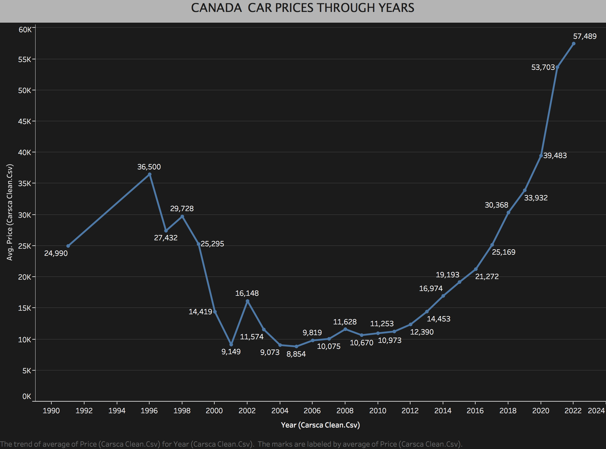
FINDINGS
PRICE VS YEAR - CANDA
The price for cars from 1995 and 2021 onwards have relatively higher price
Notes:
Links:
https://www.pexels.com/photo/female-engineer-planning-dam-3862389/

Slide 19
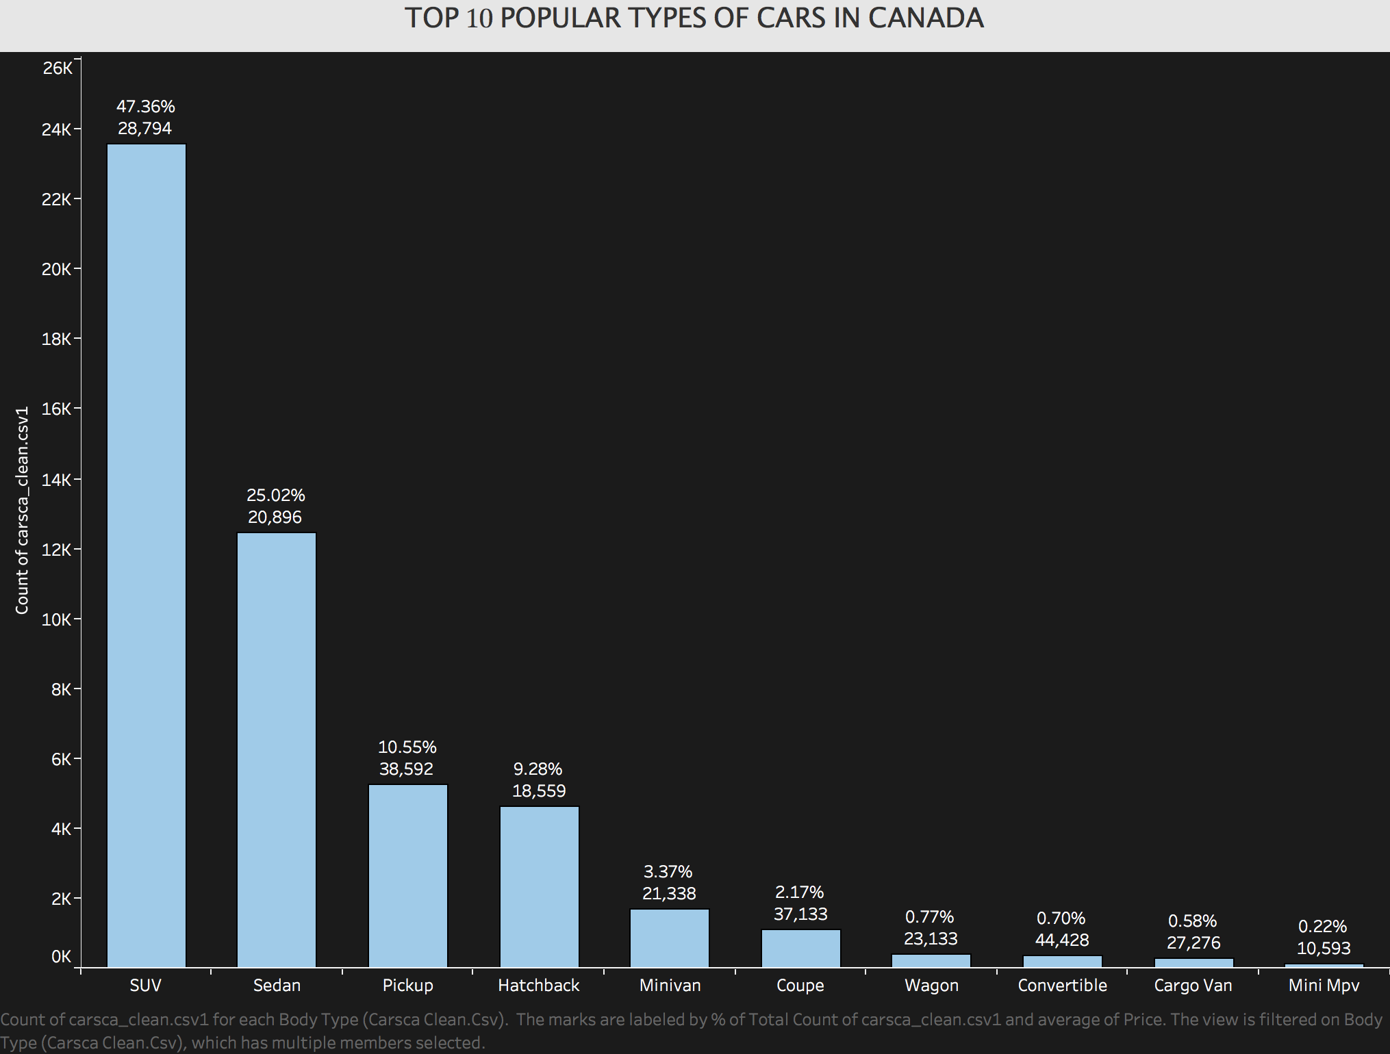
FINDINGS
TOP 10 TYPES OF CARS IN CANADA / AVERAGE
PRICE
SUV – $ 28,794
SEDAN- $ 20,896
PICKUP – $ 38,592
HATCHBACK - $ 18,559
MINIVAN - $ 21,338
COUPE – $ 37,133
WAGON – $ 23,133
CONVERTIBLE – $ 44,428
CARGO VAN –$ 27,276
MINI MPV – $10,593
Notes:
Links:
https://www.pexels.com/photo/female-engineer-planning-dam-3862389/

Slide 20
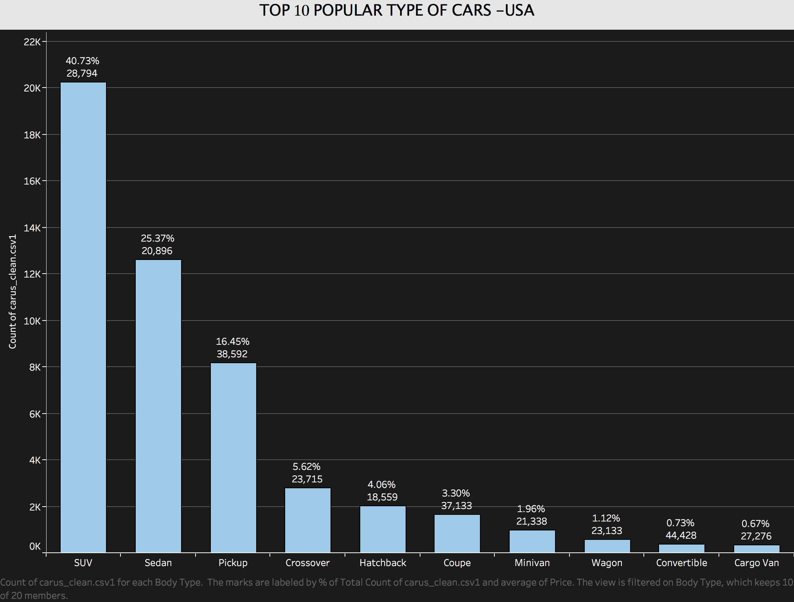
FINDINGS
TOP 10 TYPES OF CARS IN USA / AVERAGE
PRICE
SUV -$28,794
SEDAN-$ 20.896
PICKUP- $38,592
CROSSOVER -23,715
HATCHBACK – $18,559
COUPE – $37,133
MINIVAN -$21,338
WAGON- $23,133
CONVERTIBLE - $44,428
CARGO VAN -$ 27,276
Notes:
Links:
https://www.pexels.com/photo/female-engineer-planning-dam-3862389/

Slide 21
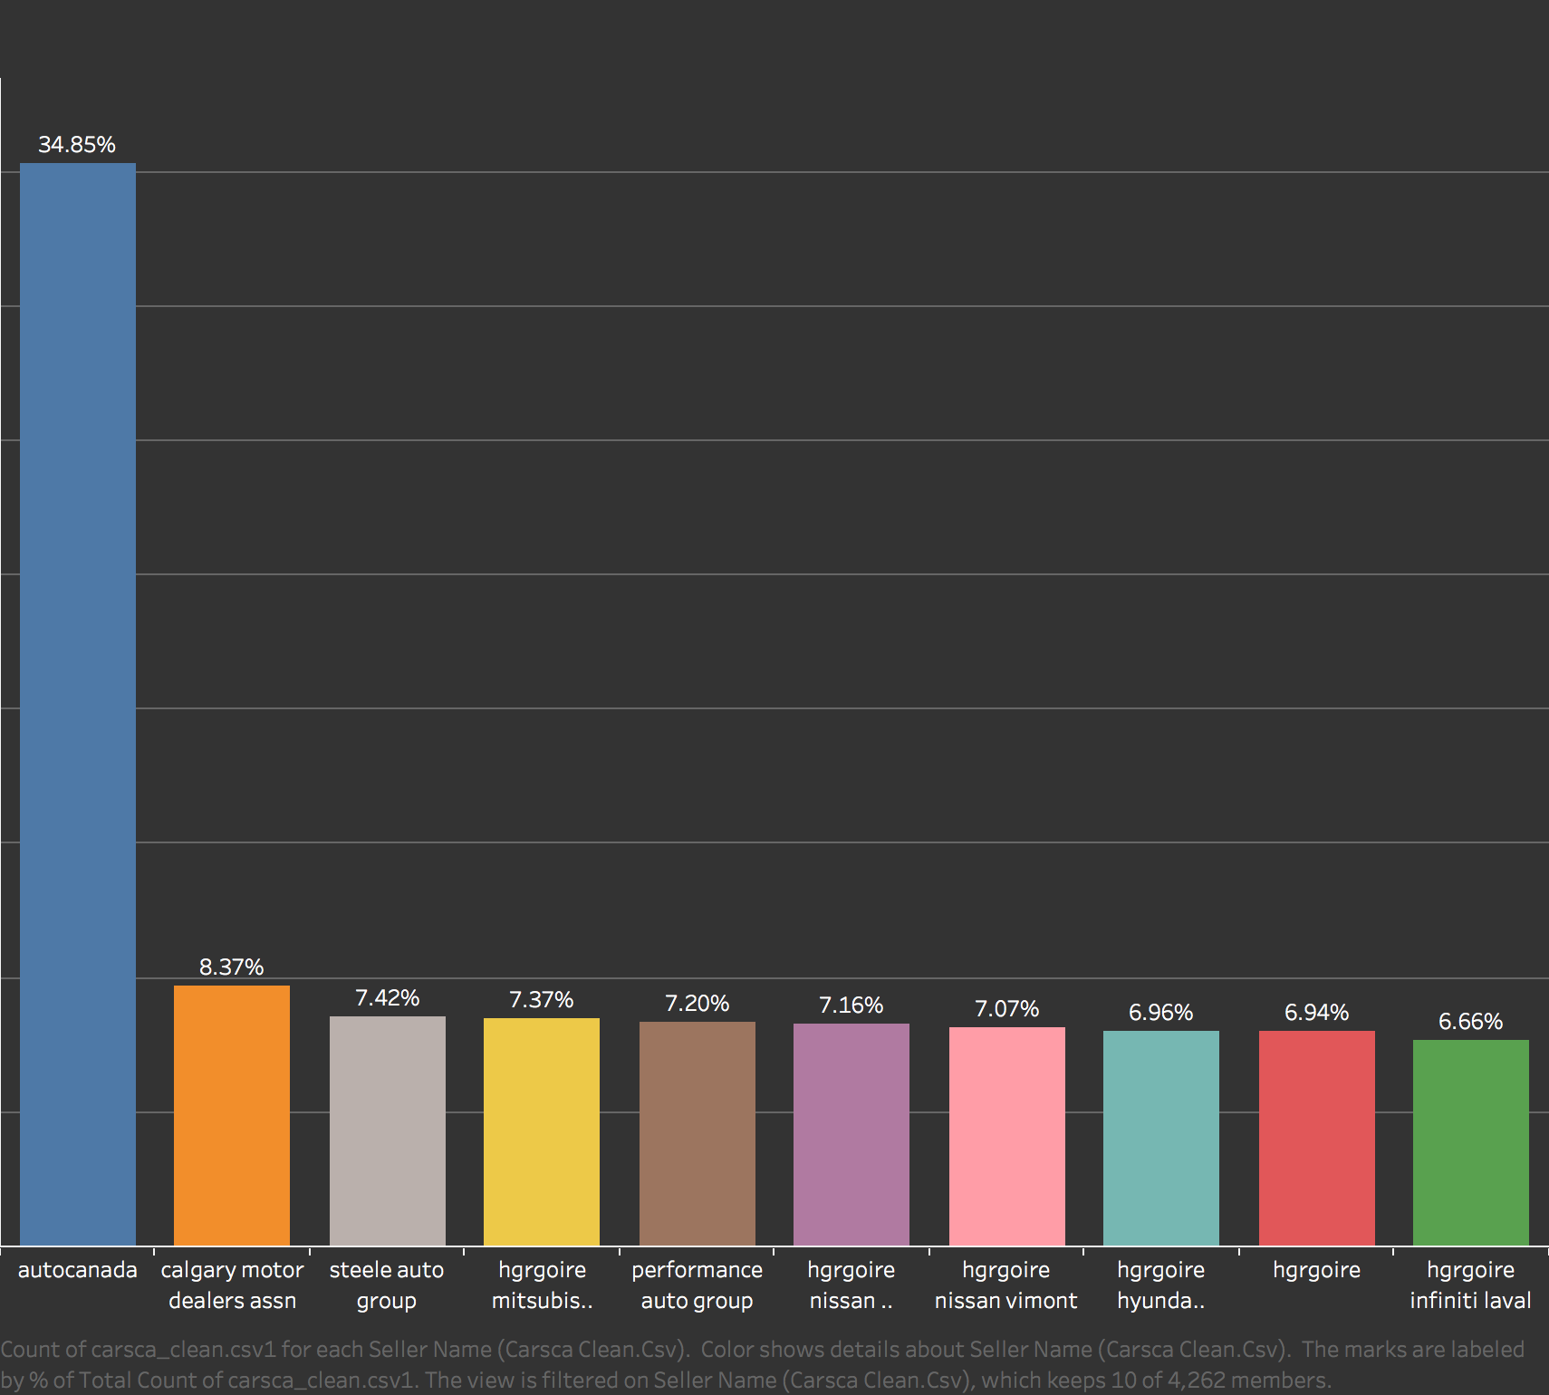
FINDINGS
TOP 10 SELLERS IN CANADA
Notes:
Links:
https://www.pexels.com/photo/female-engineer-planning-dam-3862389/

Slide 22
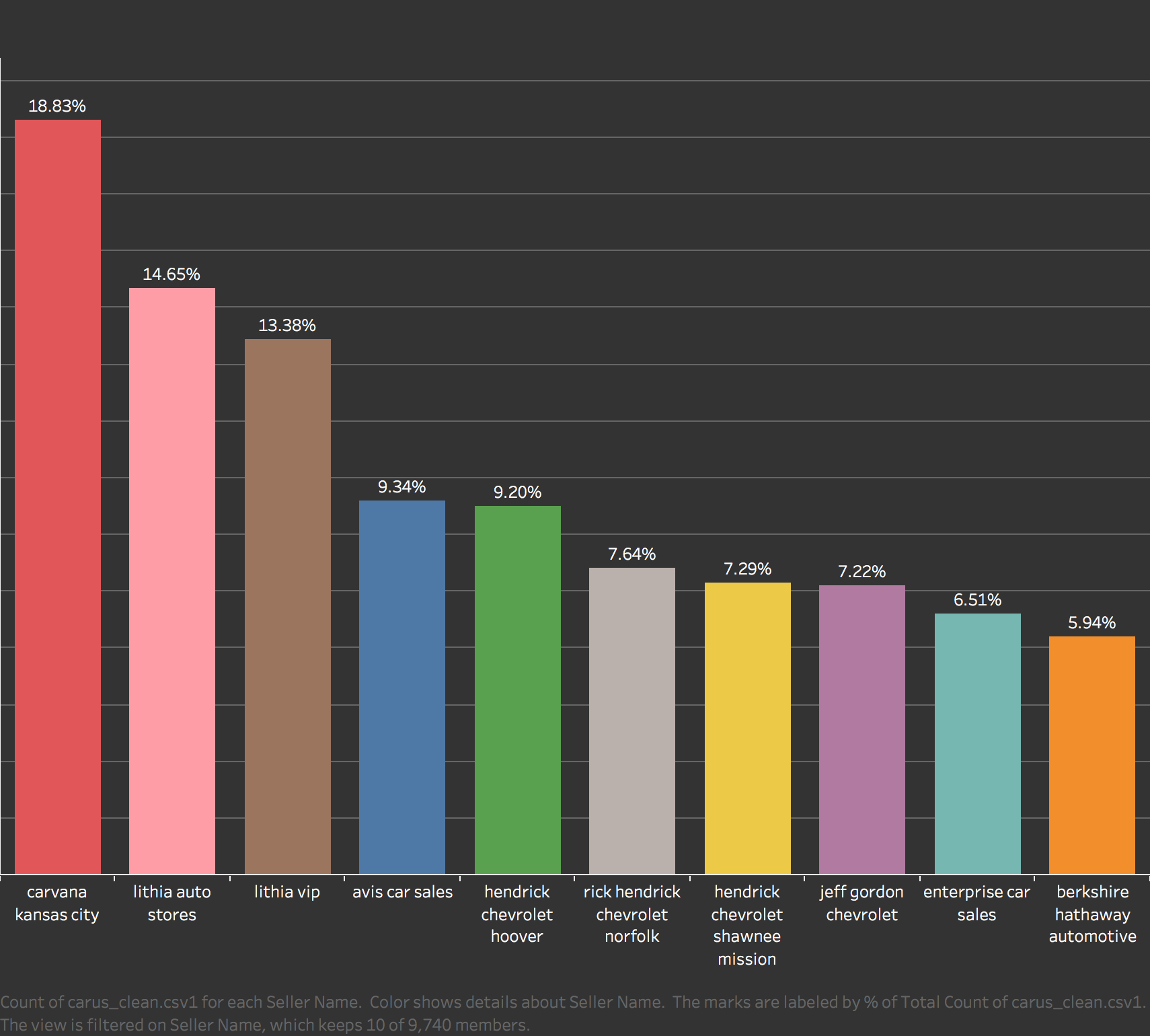
FINDINGS
TOP 10 SELLERS IN USA
Notes:
Links:
https://www.pexels.com/photo/female-engineer-planning-dam-3862389/

Slide 23
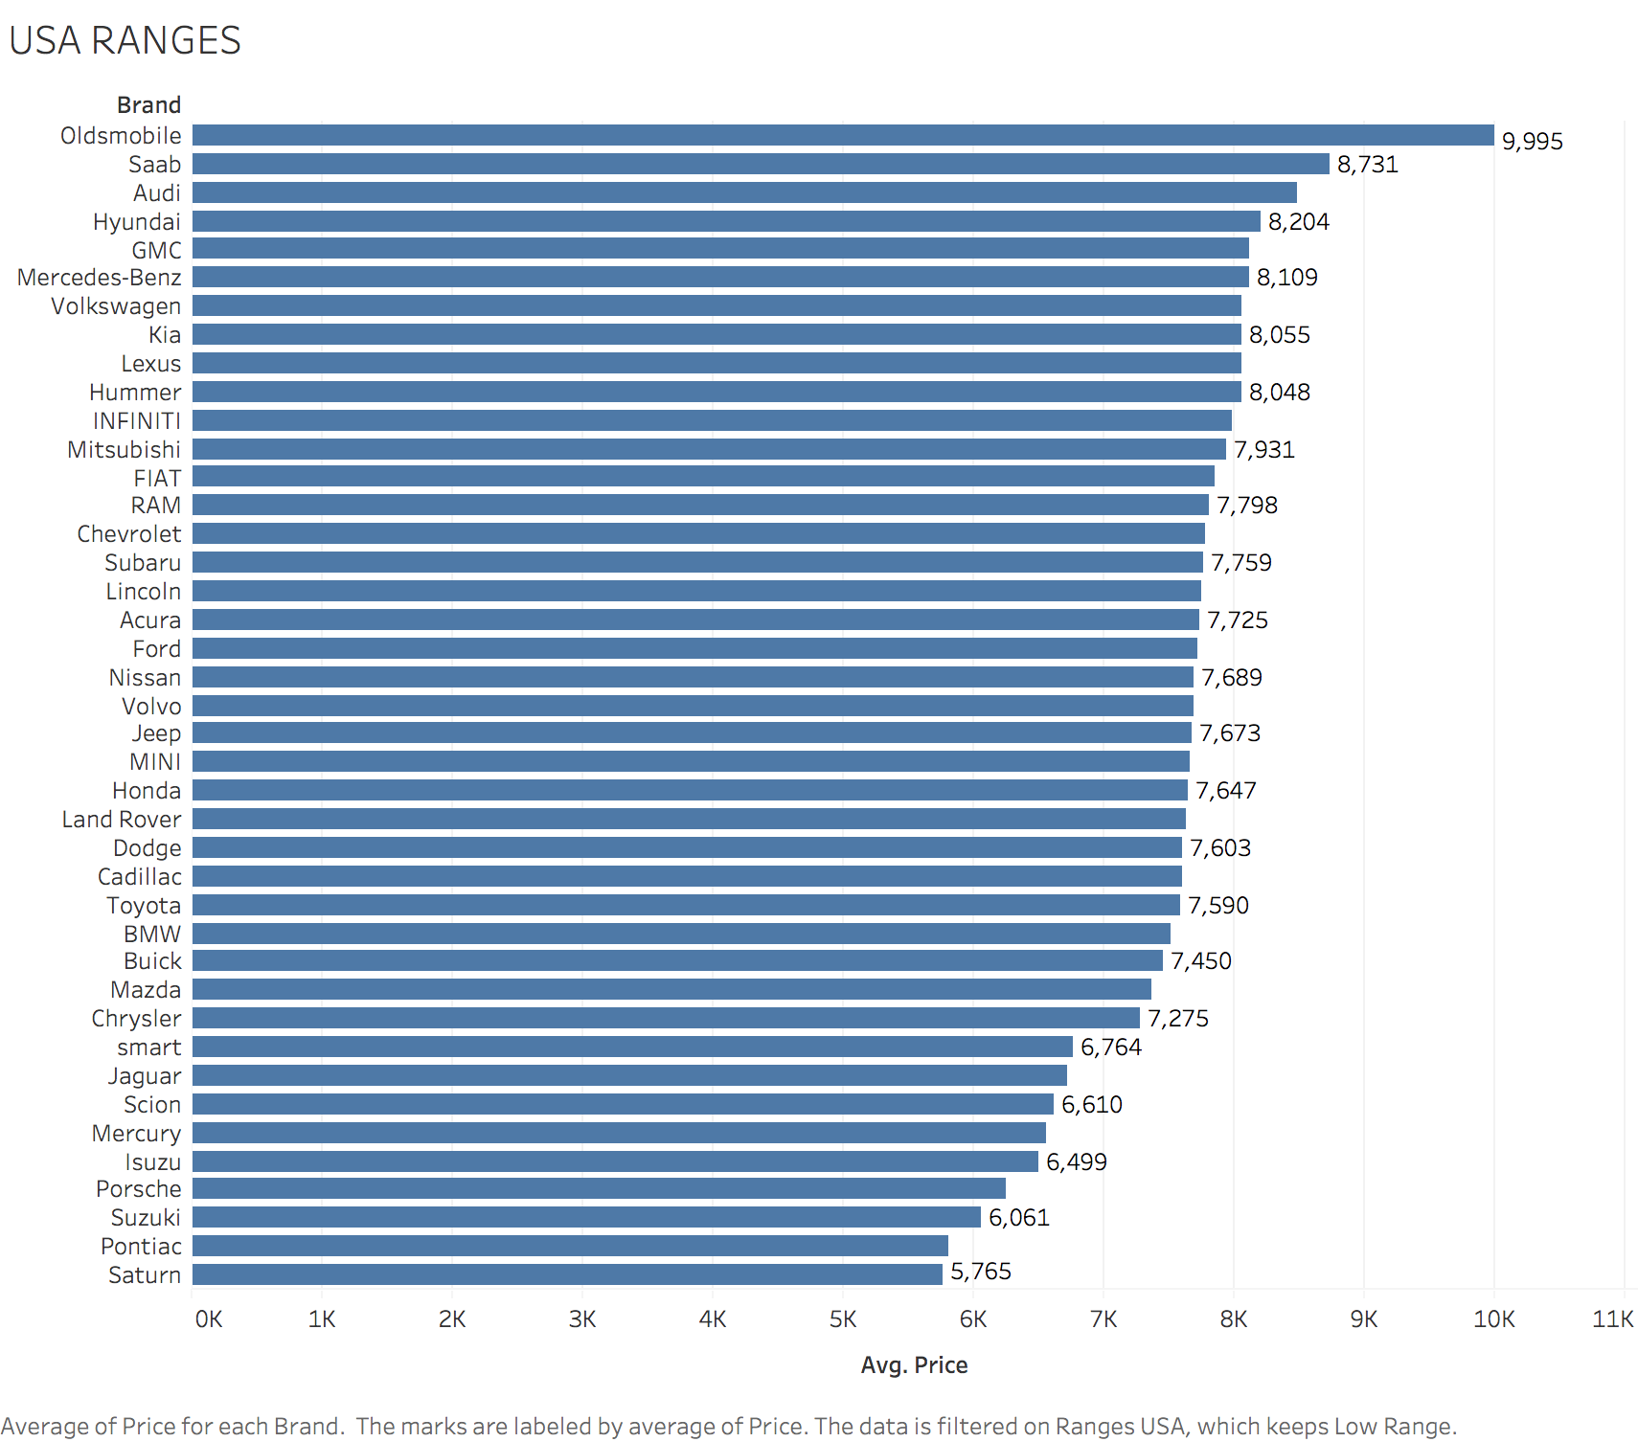
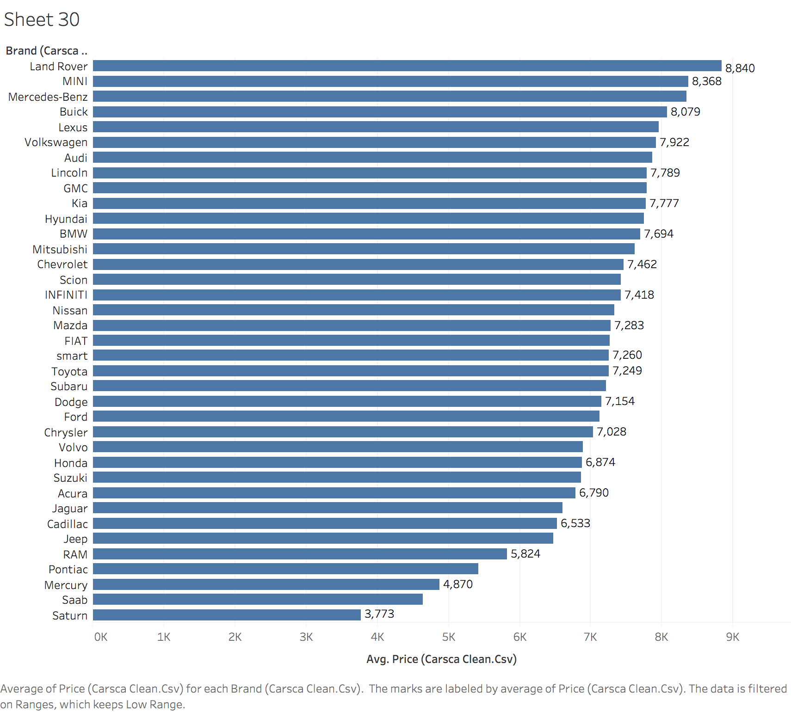
LOW RANGE
USA
CANADA
Notes:
Links:
https://www.pexels.com/photo/female-engineer-planning-dam-3862389/

Slide 24
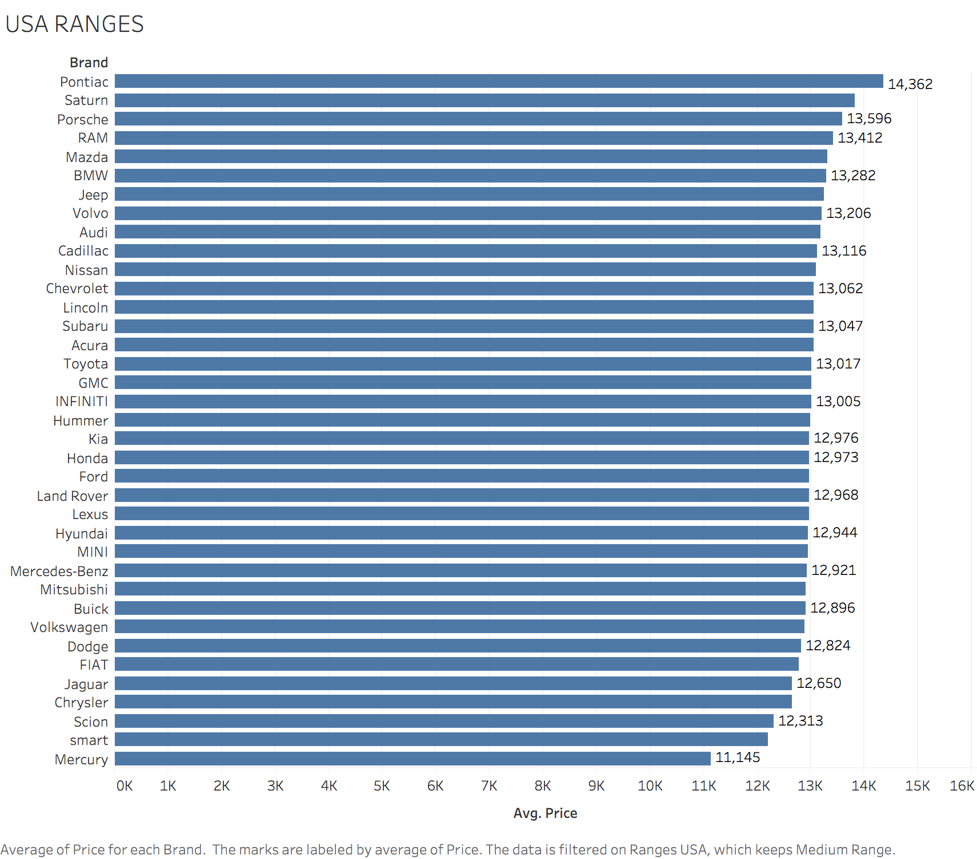
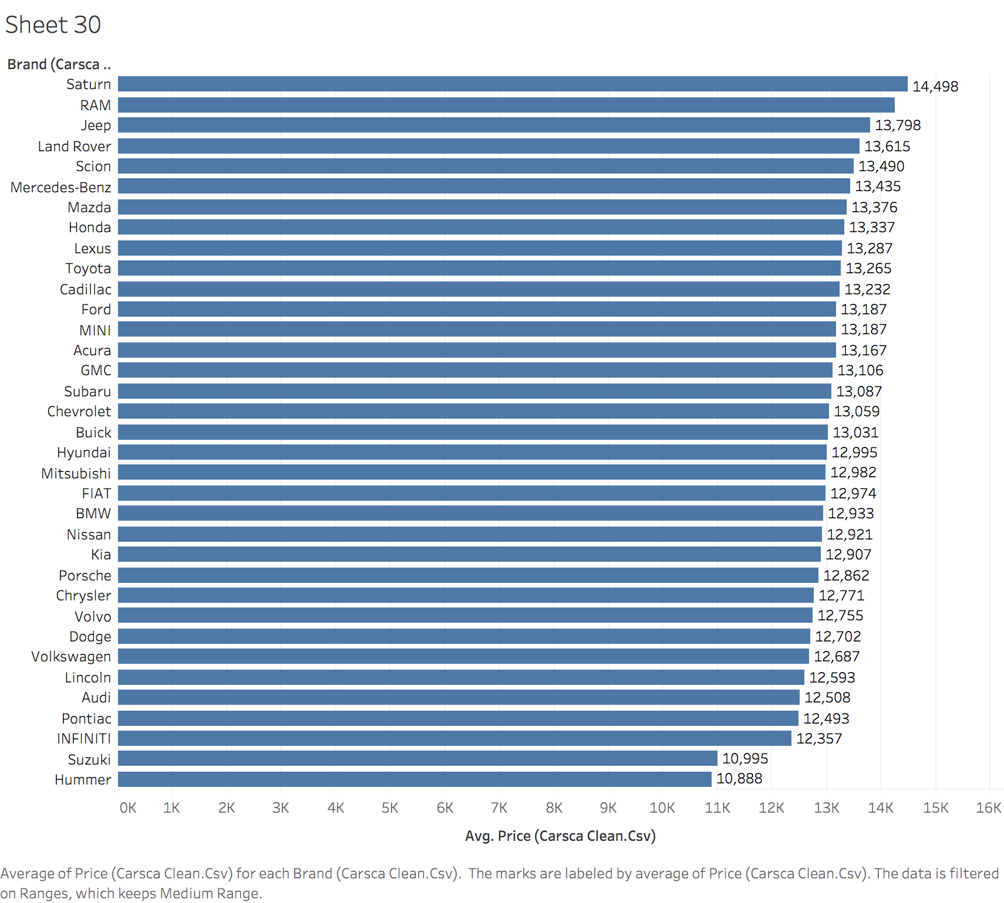
MEDIUM RANGE
USA
CANADA
Notes:
Links:
https://www.pexels.com/photo/female-engineer-planning-dam-3862389/

Slide 25
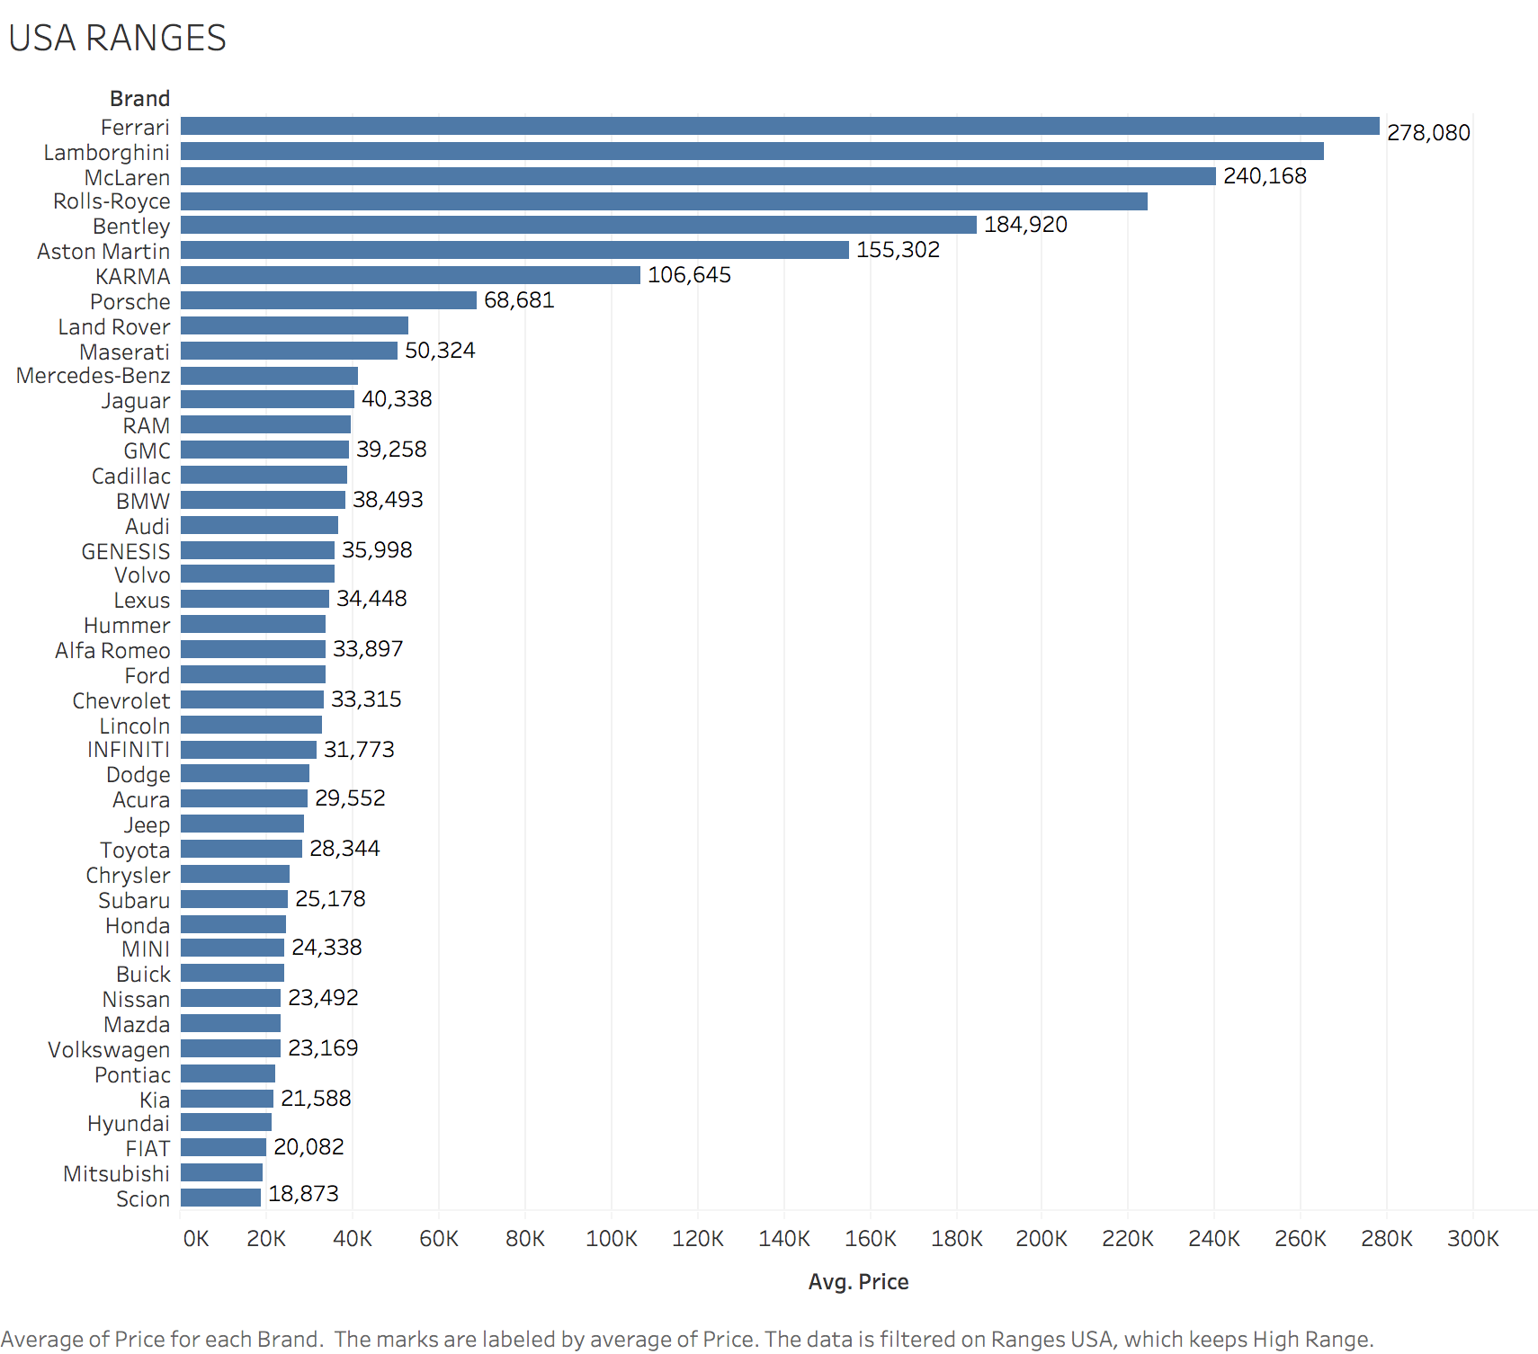
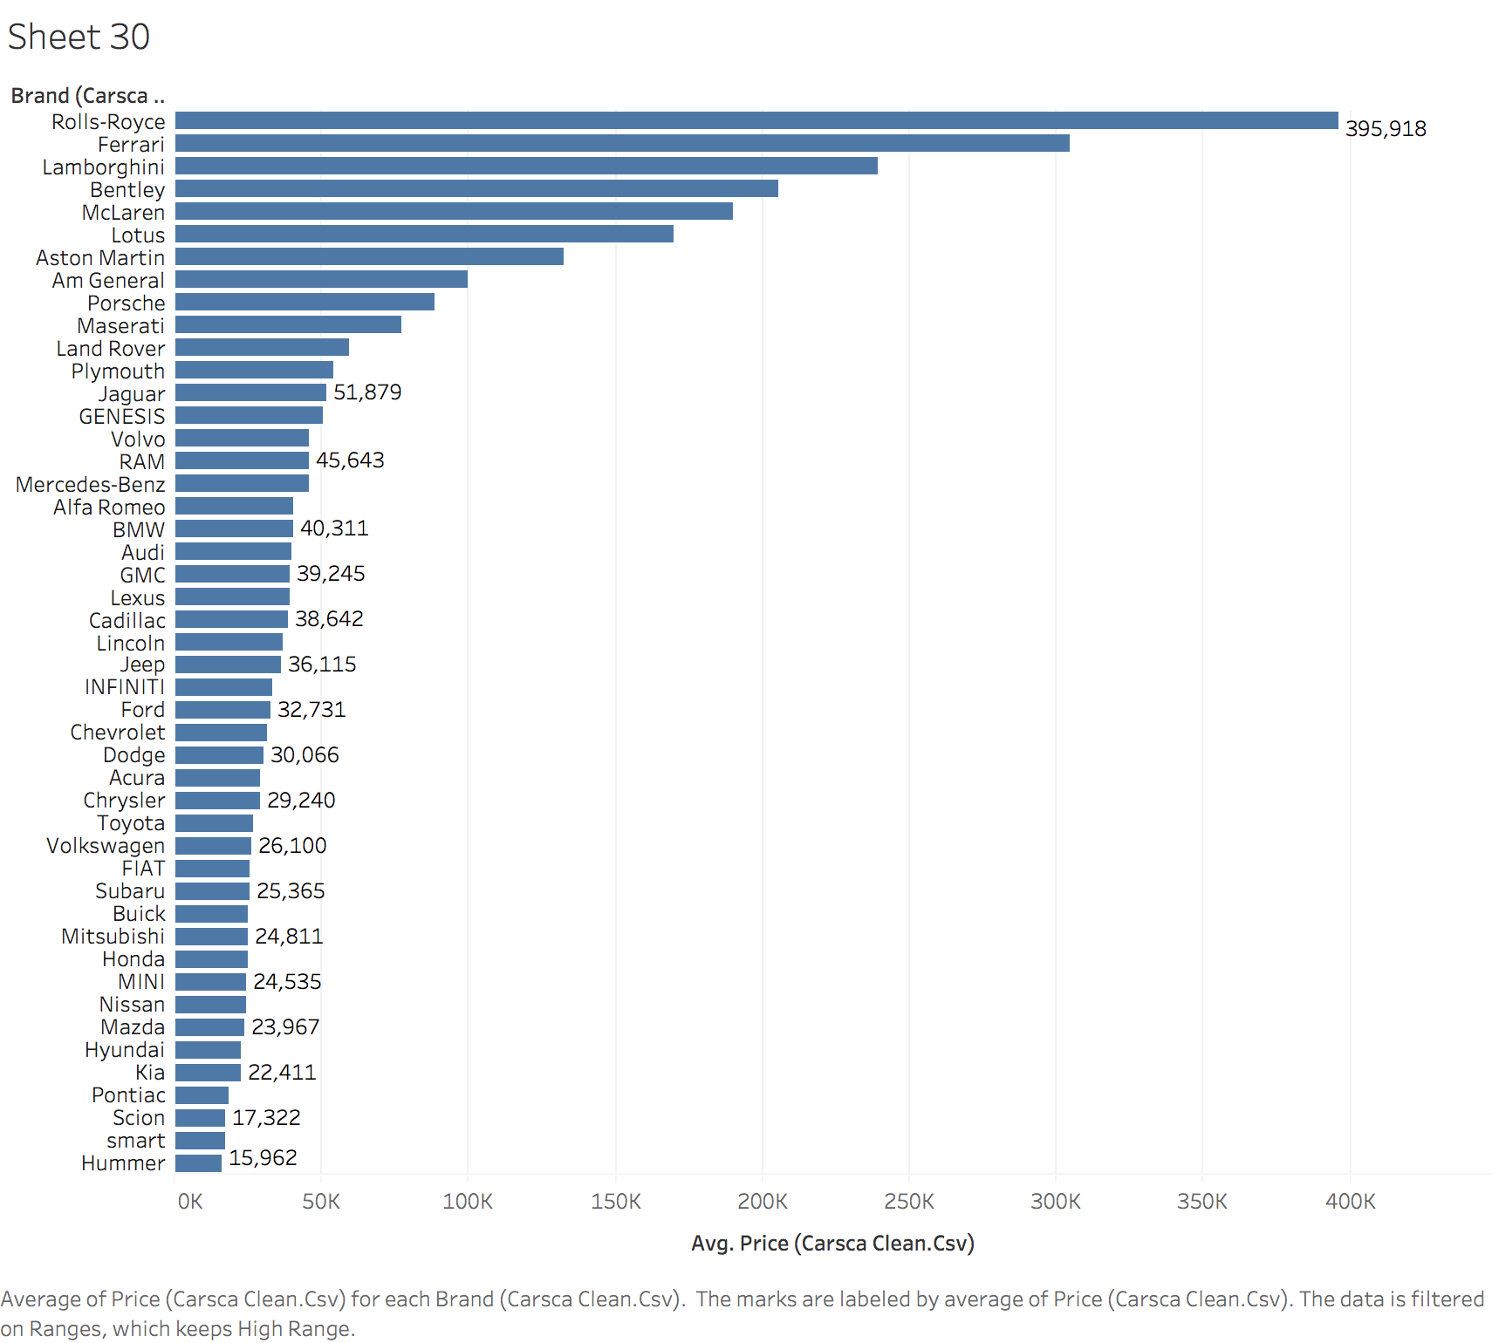
HIGH RANGE
USA
CANADA
Notes:
Links:
https://www.pexels.com/photo/female-engineer-planning-dam-3862389/

Slide 26



THE DASHBOARD
Dataset Overview
Canada and USA used car dataset
Link to tableau public
https://public.tableau.com/views/USEDCARS-CA-USA/Dashboard3?:language=en-US&publish=yes&:display_count=n&:origin=viz_share_link
OR Scan the QR
Link to GitHub
https://github.com/disuhitarth/CANADA_US-Used-Cars-Analysis
OR Scan the QR
Notes:
Links:
https://www.pexels.com/photo/top-view-of-people-at-the-meeting-3184287/

Slide 27
THANK
YOU!
Notes:
Links:
https://www.pexels.com/photo/photo-of-people-holding-each-other-s-hands-3184423/

